Slide 1
CONTEXT
Taking into consideration the employment of Data Science for supporting marketing decisions, the Portuguese National Tourism Board Organization (PT – NTBO) as the body responsible for tourism promotion, has a purpose to find the best strategy to apply to next marketing campaings. After Covid-19 Pandemic, the global economic environment were affected, specially on Tourism sector. Thus, regarding this new global scenarium, new strategies must be taken to bring its economy to another level.

Slide 2
APPROACH & STRATEGY
Our strategy vision passed through going deep into the Portuguese Tourism market first and understanding its main attractions and visitors, in order to find the best approach to find marketing opportunities.
The methodology which described our approach is based on CRISP-DM guidelines combined with Python Language, applying concepts such as RFM Model to build segmentation and Similarity to find assertive recommendations.

Slide 3
APPROACH & STRATEGY
The main business goals of the project are:
Providing a comprehensive view of the real impact of the pandemic with a built scenarium before and after COVID-19.
Giving support with a useful line of marketing strategy to focus on, which is the best segment of visitors, the one who don’t spend much time to come backa and visited, have more frequency and give the best ratings.
Analyzing and identifying similarity within portuguese attractions and the ones from their competitors, to create a recommendation system where visitors could see advantages through marketing campaings in visiting Portugal.

Slide 4
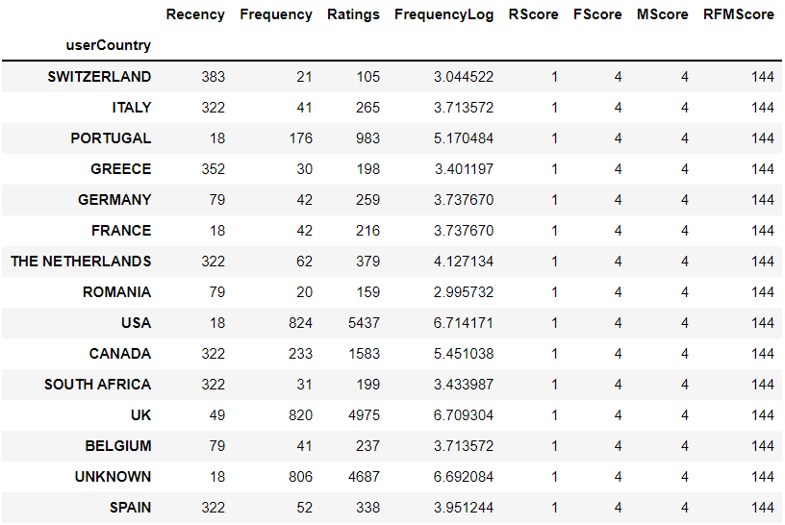
RESULTS & INSIGHTS
Who are portuguese high-value visitors?
UK
USA
Canada
Portugal
The Netherlands
Spain
Italy
Germany
Belgium
France
South Africa
Greece
Romania
Switzerland

Slide 5
RESULTS & INSIGHTS
Who are portuguese main competitors?
Country | Reviews
Spain | 163828
England | 75909
Italy | 65646
Scotland | 57180
Portugal | 55541
Poland | 51324
Austria | 42555
France | 42192
Greece | 41233
Russia | 36979
Attraction | Country | Reviews
Basilica of the Sagrada Familia | Spain | 8251
Tower of London | England | 5515
Edinburgh Castle | Scotland | 4907
The Roman Baths | Spain | 2866
Parc Guell | Czech Republic | 2829
Old Town | Croatia | 2707
Acropolis | Greece | 2668
Schönbrunn Palace | Austria | 2388
Real Alcazar de Sevilla | Spain | 2027
Westminster Abbey | England | 1892

Slide 6
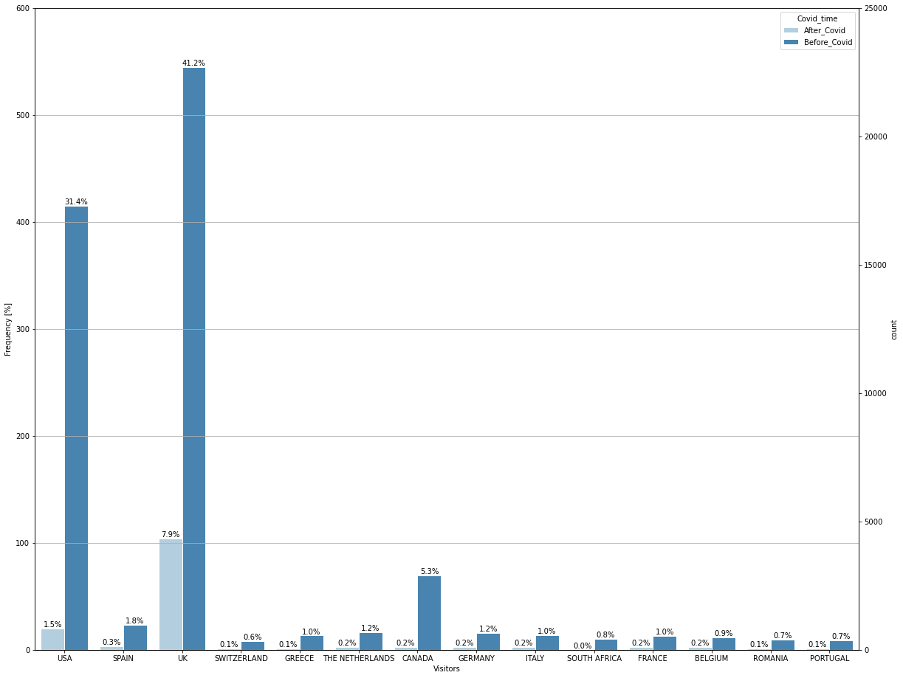
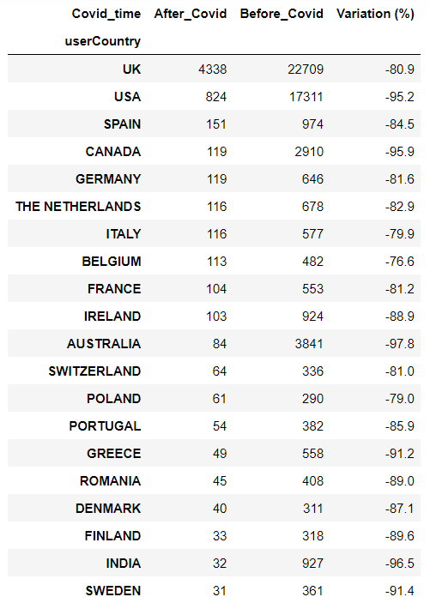
RESULTS & INSIGHTS
How was the covid impact?

Slide 7
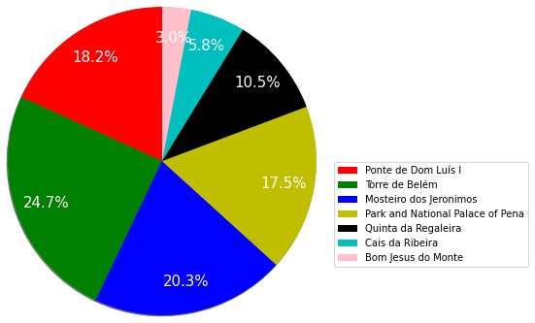
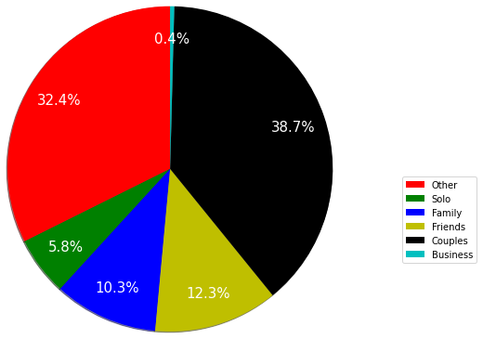
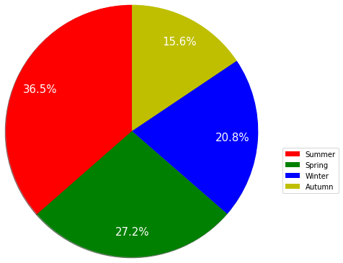
RESULTS & INSIGHTS
What are their favorite Portuguese attractions?
What are their favorite trip type in Portugal
What are their favorite season in Portugal?

Slide 8
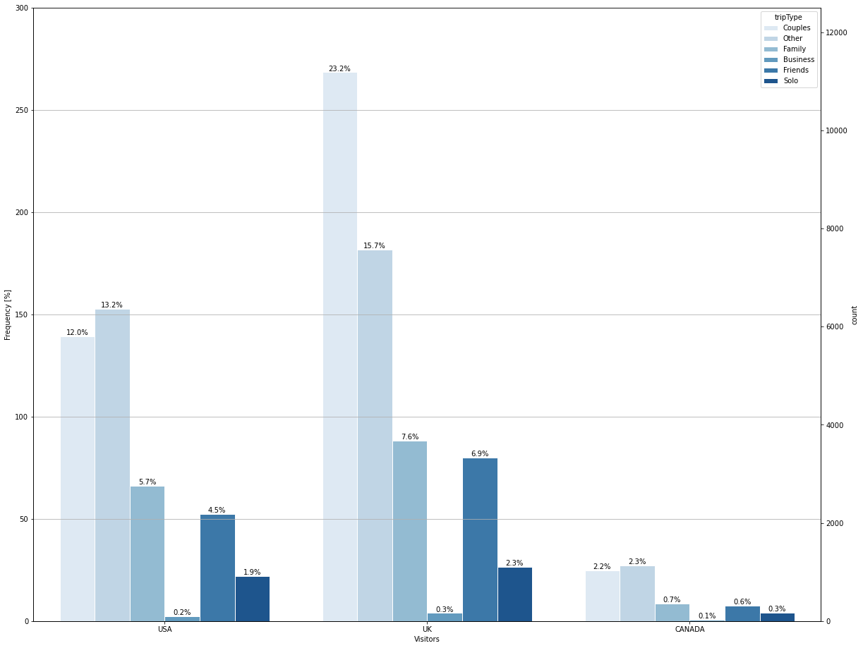
RESULTS & INSIGHTS
High-value visitors Patterns
– TripType in Portugal
Top3:
UK
USA
CANADA

Slide 9
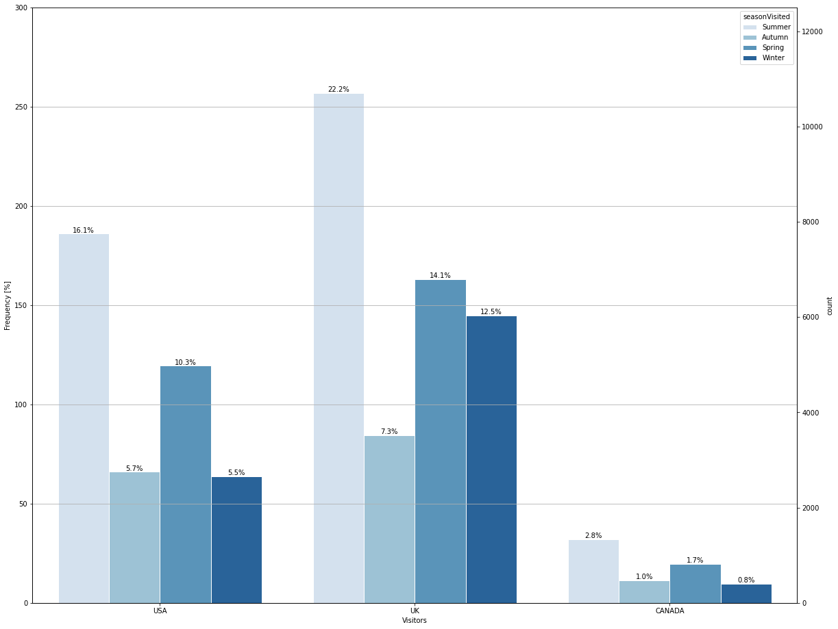
RESULTS & INSIGHTS
High-value visitors Patterns
– Seasons in Portugal
Top3:
UK
USA
CANADA

Slide 10
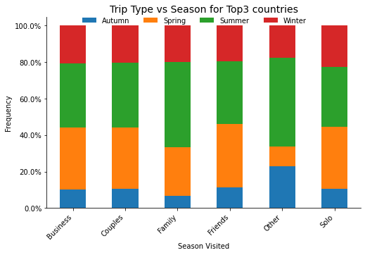
RESULTS & INSIGHTS
High-value visitors Patterns
– Trip Type vs. Seasons
Top3:
UK
USA
CANADA

Slide 11
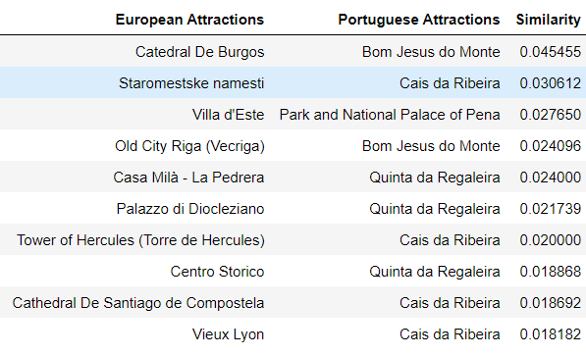
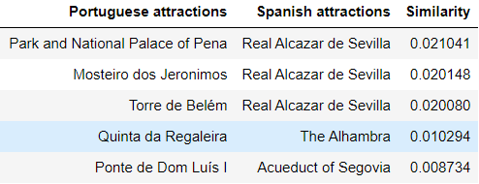
RESULTS & INSIGHTS
Recommendations system
Recommendation system 1 – based on the high-value visitor: the UK market, and considering the European sites they visited.
Recommendation system 2 – using Spain as a leading competitor and considering its attractions to recommend Portuguese attractions to their visitors.

Slide 12

MARKETING ACTIONS

Slide 13

Final Remarks

Slide 14
Thank you

